Slide 1


Day 17
Math24 (Differential Equations)
Ch 3.2 Solutions of Linear Homogeneous Equations; The Wronskian (Page 145-158)
Elementary Differential Equations and Boundary Value Problems, 10th edition, by William E. Boyce and Richard C. DiPrima, ©2013 by John Wiley & Sons, Inc.

Slide 2

Let p, q be continuous functions on an interval I = (α, β), which could be infinite. For any function y that is twice differentiable on I, define the differential operator L by
Note that L[y] is a function on I, with output value
For example,

Slide 3


Differential Operator Notation
In this section we will discuss the second order linear homogeneous equation L[y](t) = 0, along with initial conditions as indicated below:
We would like to know if there are solutions to this initial value problem, and if so, are they unique.
Also, we would like to know what can be said about the form and structure of solutions that might be helpful in finding solutions to particular problems.
These questions are addressed in the theorems of this section.

Slide 4


Theorem 3.2.1 (Existence and Uniqueness)
Consider the initial value problem
where p, q, and g are continuous on an open interval I that contains t₀. Then there exists a unique solution y = φ(t) on I.
Note: While this theorem says that a solution to the initial value problem above exists, it is often not possible to write down a useful expression for the solution. This is a major difference between first and second order linear equations.

Slide 5
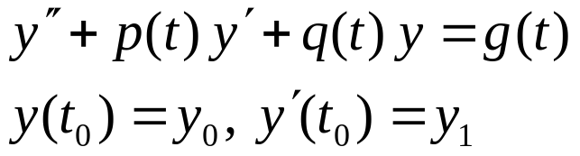

Example 1
Consider the second order linear initial value problem
Wrting the differential equation in the form :
The only points of discontinuity for these coefficients are t = 0 and t = 3. So the longest open interval containing the initial point t =1 in which all the coefficients are continuous is 0 < t < 3
Therefore, the longest interval in which Theorem 3.2.1 guarantees the existence of the solution is 0 < t < 3

Slide 6
Example 2
Consider the second order linear initial value problem
where p, q are continuous on an open interval I containing t₀.
In light of the initial conditions, note that y = 0 is a solution to this homogeneous initial value problem.
Since the hypotheses of Theorem 3.2.1 are satisfied, it follows that y = 0 is the only solution of this problem.

Slide 7

Theorem 3.2.2 (Principle of Superposition)
If y₁and y₂ are solutions to the equation
then the linear combination c₁y₁ + y₂c₂ is also a solution, for all constants c₁ and c₂.
To prove this theorem, substitute c₁y₁ + y₂c₂ in for y in the equation above, and use the fact that y₁ and y₂ are solutions.
Thus for any two solutions y₁ and y₂, we can construct an infinite family of solutions, each of the form y = c₁y₁ + c₂ y₂.
Can all solutions can be written this way, or do some solutions have a different form altogether? To answer this question, we use the Wronskian determinant.

Slide 8

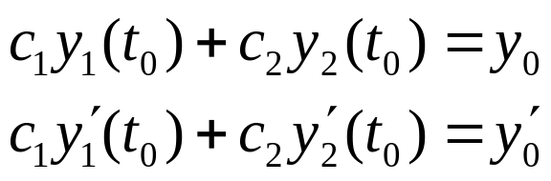
The Wronskian Determinant (1 of 3)
Suppose y₁ and y₂ are solutions to the equation
From Theorem 3.2.2, we know that y = c₁y₁ + c₂ y₂ is a solution to this equation.
Next, find coefficients such that y = c₁y₁ + c₂ y₂ satisfies the initial conditions
To do so, we need to solve the following equations:

Slide 9
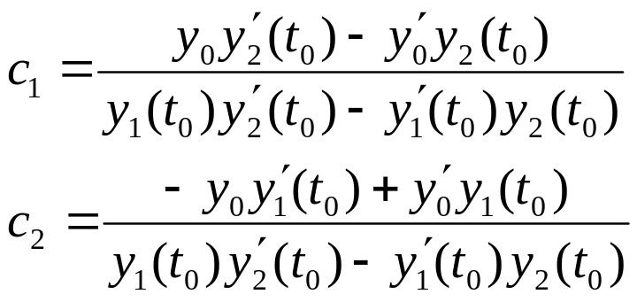
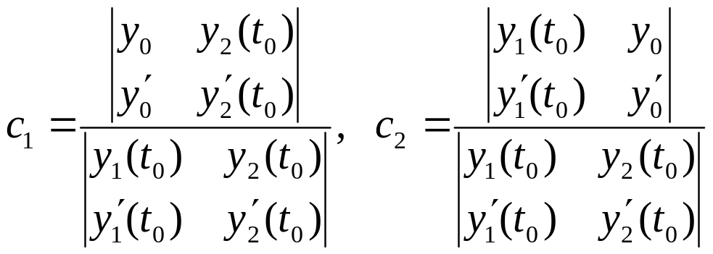
The Wronskian Determinant (2 of 3)
Solving the equations, we obtain
In terms of determinants:

Slide 10
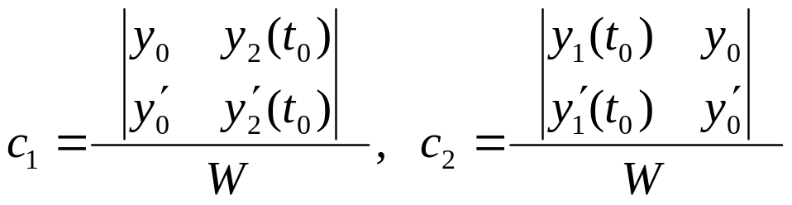
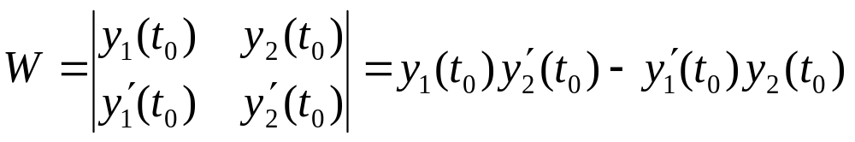

The Wronskian Determinant (3 of 3)
In order for these formulas to be valid, the determinant W in the denominator cannot be zero:
W is called the Wronskian determinant, or more simply, the Wronskian of the solutions y₁and y₂. We will sometimes use the notation

Slide 11




Theorem 3.2.3
Suppose y₁ and y₂ are solutions to the equation
with the initial conditions
Then it is always possible to choose constants c₁, c₂ so that
satisfies the differential equation and initial conditions if and ony if the Wronskian
is not zero at the point t₀

Slide 12


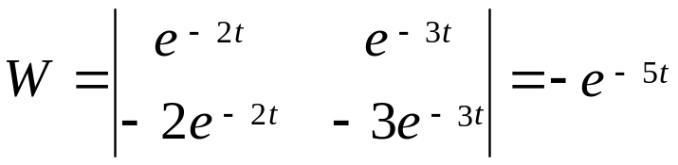

Example 3
In Example 2 of Section 3.1, we found that
were solutions to the differential equation
The Wronskian of these two functions is
Since W is nonzero for all values of t, the functions
can be used to construct solutions of the differential equation with initial conditions at any value of t

Slide 13

Theorem 3.2.4 (Fundamental Solutions)
Suppose y₁ and y₂ are solutions to the equation
Then the family of solutions
y = c₁y₁ + c₂ y₂
with arbitrary coefficients c₁, c₂ includes every solution to the differential equation if an only if there is a point t₀ such that W(y₁,y₂)(t₀) ≠ 0, .
The expression y = c₁y₁ + c₂ y₂ is called the general solution of the differential equation above, and in this case y₁ and y₂ are said to form a fundamental set of solutions to the differential equation.

Slide 14

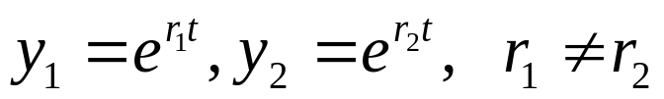
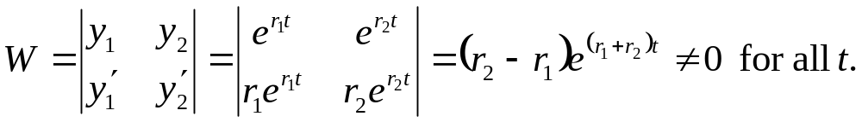
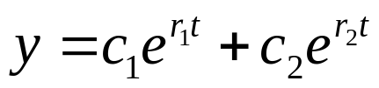
Example 4
Consider the general second order linear equation below, with the two solutions indicated:
Suppose the functions below are solutions to this equation:
The Wronskian of y₁and y₂ is
Thus y₁and y₂ form a fundamental set of solutions to the equation, and can be used to construct all of its solutions.
The general solution is

Slide 15


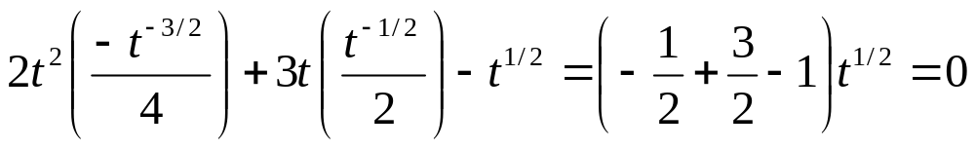
Example 5: Solutions (1 of 2)
Consider the following differential equation:
Show that the functions below are fundamental solutions:
To show this, first substitute y₁ into the equation:
Thus y₁ is a indeed a solution of the differential equation.
Similarly, y₂ is also a solution:

Slide 16
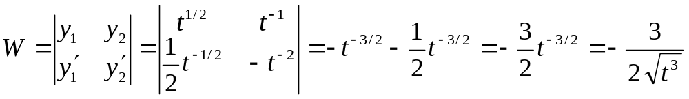
Example 5: Fundamental Solutions (2 of 2)
Recall that
To show that y₁ and y₂ form a fundamental set of solutions, we evaluate the Wronskian of y₁ and y₂:
Since W ≠ 0 for t > 0, y₁, y₂ form a fundamental set of solutions for the differential equation

Slide 17


Theorem 3.2.5: Existence of Fundamental Set of Solutions
Consider the differential equation below, whose coefficients p and q are continuous on some open interval I:
Let t₀ be a point in I, and y₁ and y₂ solutions of the equation with y₁ satisfying initial conditions
and y₂ satisfying initial conditions
Then y₁, y₂ form a fundamental set of solutions to the given differential equation.

Slide 18


Example 6: Apply Theorem 3.2.5 (1 of 3)
Find the fundamental set specified by Theorem 3.2.5 for the differential equation and initial point
In Section 3.1, we found two solutions of this equation:
The Wronskian of these solutions is W(y₁, y₂)(t₀) = -2 ≠ 0 so they form a fundamental set of solutions.
But these two solutions do not satisfy the initial conditions stated in Theorem 3.2.5, and thus they do not form the fundamental set of solutions mentioned in that theorem.
Let y₃ and y₄ be the fundamental solutions of Thm 3.2.5.

Slide 19
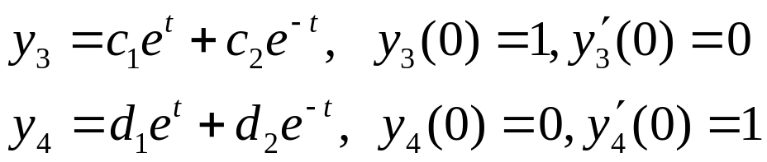
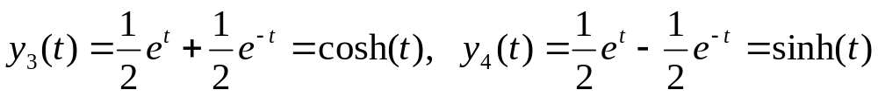
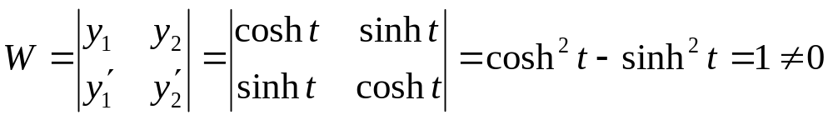

Example 6: General Solution (2 of 3)
Since y₁ and y₂ form a fundamental set of solutions,
Solving each equation, we obtain
The Wronskian of y₃ and y₄ is
Thus y₃, y₄ form the fundamental set of solutions indicated in Theorem 3.2.5, with general solution in this case

Slide 20

Example 6:
Many Fundamental Solution Sets (3 of 3)
Thus
both form fundamental solution sets to the differential equation and initial point
In general, a differential equation will have infinitely many different fundamental solution sets. Typically, we pick the one that is most convenient or useful.

Slide 21
Theorem 3.2.6
Consider again the equation (2):
where p and q are continuous real-valued functions. If y = u(t) + iv(t) is a complex-valued solution of Eq. (2), then its real part u and its imaginary part v are also solutions of this equation.

Slide 22
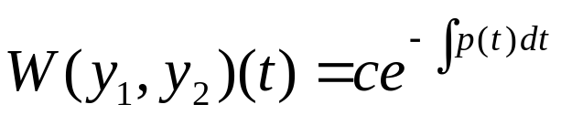
Theorem 3.2.7 (Abel’s Theorem)
Suppose y₁ and y₂ are solutions to the equation
where p and q are continuous on some open interval I. Then the W(y₁,y₂)(t) is given by
where c is a constant that depends on y₁ and y₂ but not on t.
Note that W(y₁,y₂)(t) is either zero for all t in I (if c = 0) or else is never zero in I (if c ≠ 0).

Slide 23
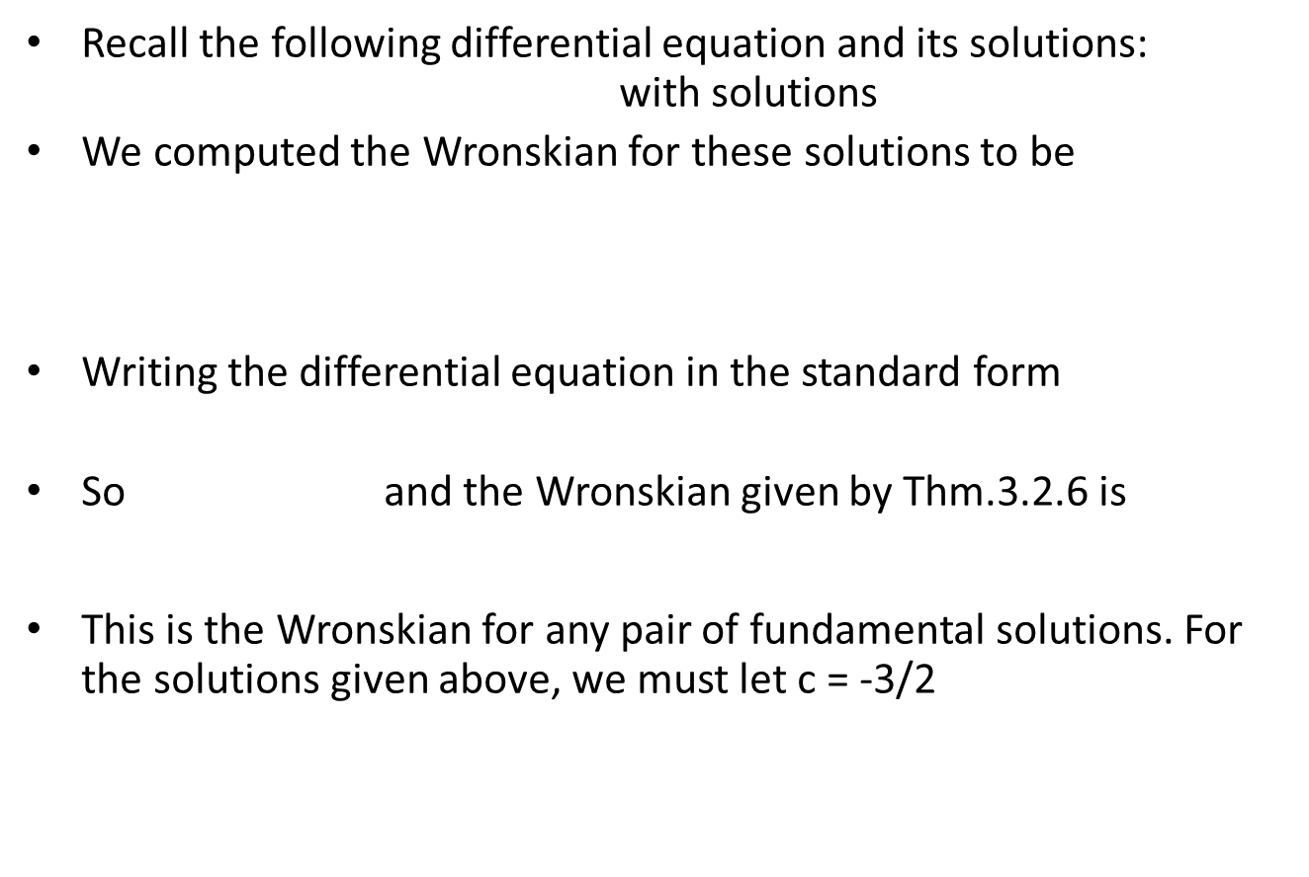
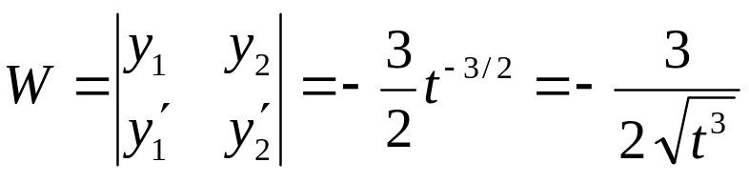

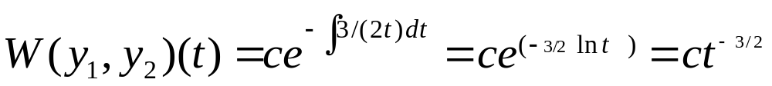
Example 7 Apply Abel’s Theorem

Slide 24
Summary
To find a general solution of the differential equation
we first find two solutions y₁ and y₂.
Then make sure there is a point t₀ in the interval such that W(y₁, y₂)(t₀) ≠ 0.
It follows that y₁ and y₂ form a fundamental set of solutions to the equation, with general solution y = c₁y₁ + c₂ y₂.
If initial conditions are prescribed at a point t₀ in the interval where W ≠ 0, then c₁ and c₂ can be chosen to satisfy those conditions.

